Slide 1
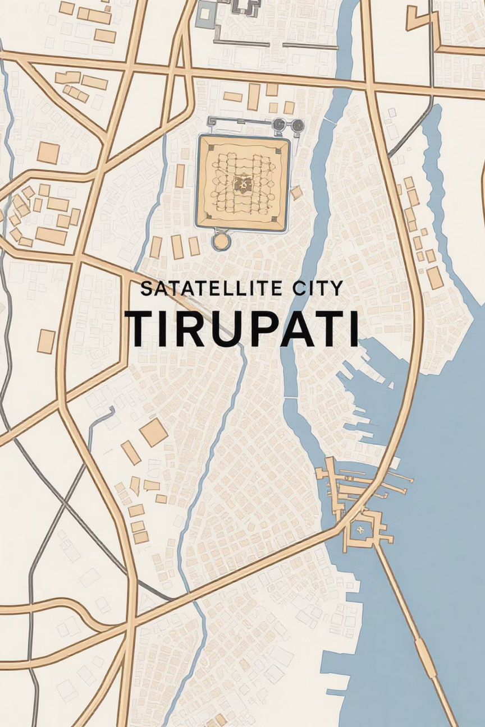

LULC Change Detection for Tirupati
2018–2023
Satellite-driven, ML-based land change intelligence
Notes:
1

Slide 2
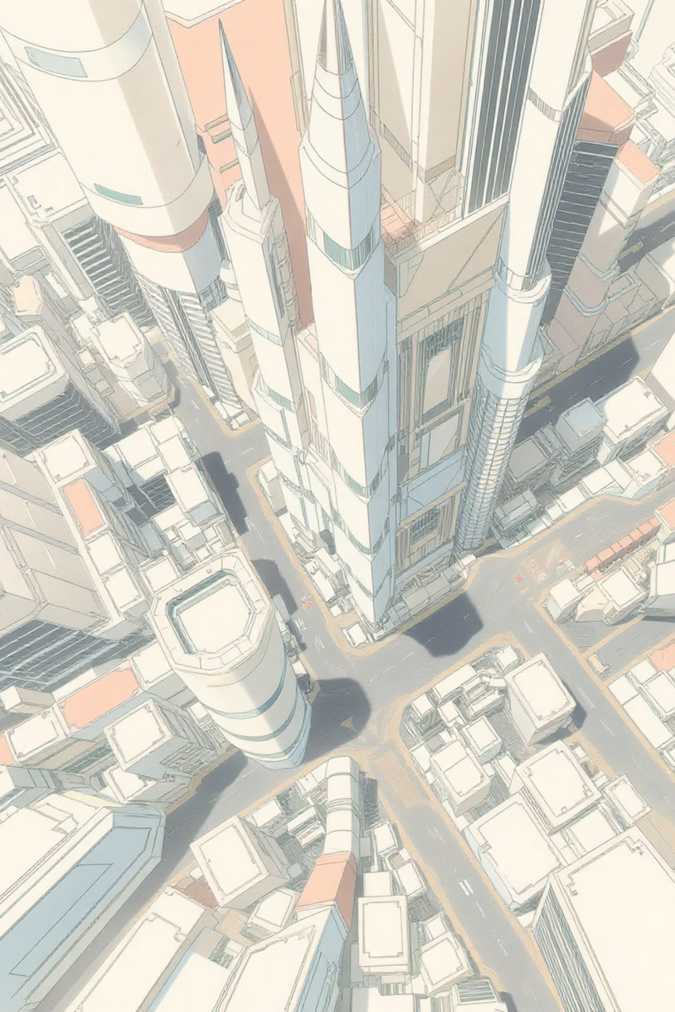
The Urban Expansion Challenge
Rapid Urbanization
Current Monitoring Gap
Tirupati is experiencing accelerated urban expansion, transforming agricultural and natural landscapes into built-up areas at unprecedented rates.
Manual land-use monitoring remains slow and subjective
Lack of automated, scalable analysis tools
Difficulty tracking changes across multiple time periods
Notes:
2

Slide 3
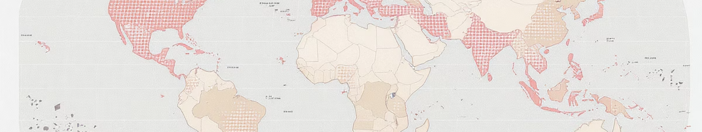



Project Objective & Scope
Detect Changes
Pixel Classification
Quantify Metrics
Identify land-use and land-cover transformations from 2018 to 2023 using satellite imagery
Classify every pixel into distinct land-cover categories with high spatial resolution
Generate area-wise statistics and percentage change measurements with confidence intervals
Notes:
3

Slide 4
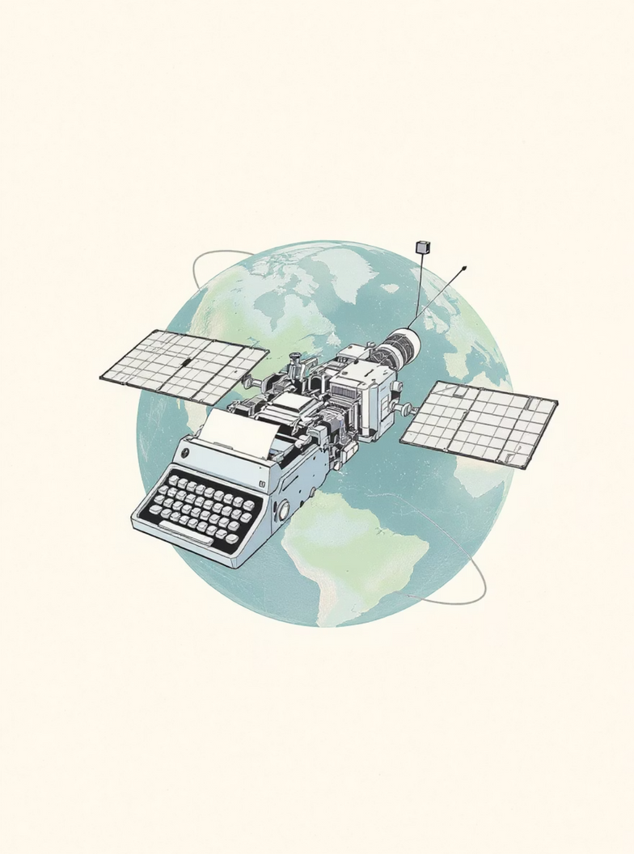
Data & Study Area
Satellite Imagery Source
Landsat satellite data providing medium-resolution, multi-spectral coverage of Tirupati's urban boundary.
2018 and 2023 temporal snapshots
Multi-footprint satellite scenes
Spectral bands for feature extraction
Notes:
4

Slide 5





Methodology Pipeline
Preprocessing
Cloud masking, image alignment, and mosaicking
Feature Extraction
Spectral bands and vegetation indices
ML Classification
Random Forest pixel-wise classification
Change Detection
Pixel-level LULC comparison
Confidence Layers
Reliability assessment
Notes:
5

Slide 6
System Architecture
01
02
03
Satellite Input
Python Processing
ML Model
Landsat imagery ingestion and quality control
GDAL-based preprocessing and raster operations
Random Forest classifier for LULC mapping
04
05
Output Generation
API Interface
Change and confidence layer creation
FastAPI serving interactive map visualization
Notes:
6

Slide 7
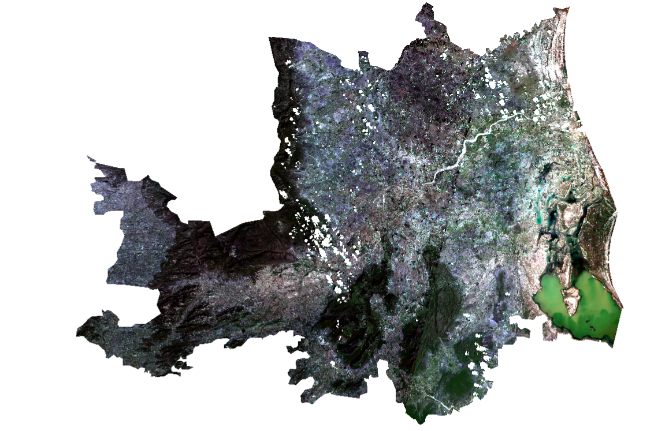
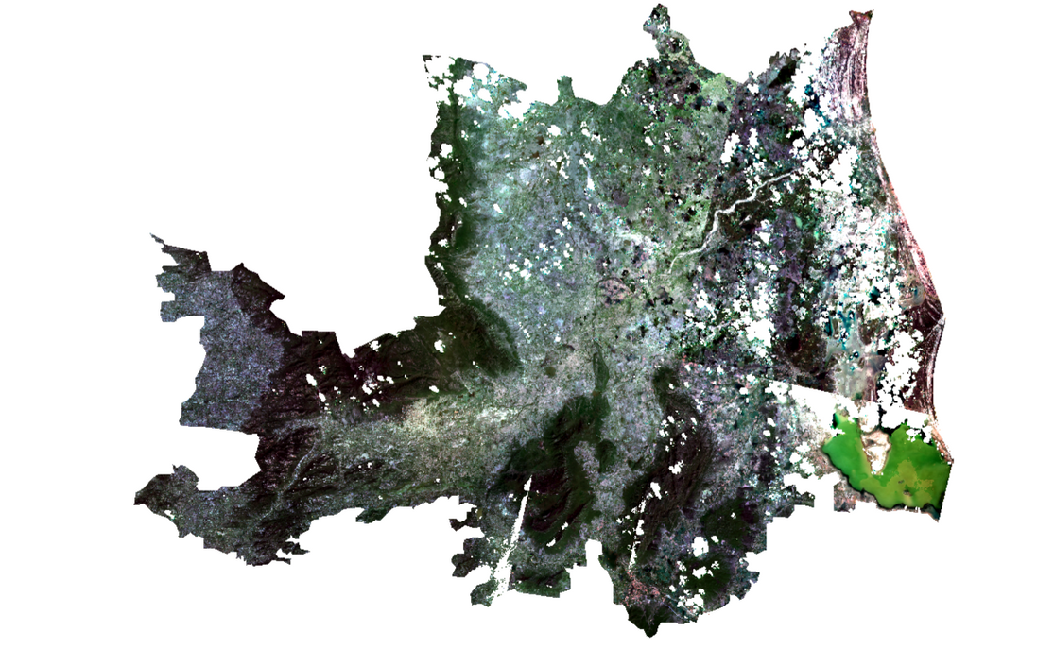
LULC Maps: 2018 vs 2023
2018 Baseline
2023 Current
Vegetation-dominated landscape with scattered built-up areas
Significant built-up expansion replacing natural cover
Notes:
7

Slide 8

Change Detection Insights
X%
Y%
Z%
Vegetation Loss
Urban Growth
Land Transformation
Conversion of green spaces to developed areas
New built-up area expansion
Major category transitions detected
Primary transition: Vegetation → Built-up, indicating urban development pressure on natural landscapes.
Notes:
8

Slide 9




Impact & Use Cases
Urban Planning
Environmental Monitoring
Smart city development and infrastructure planning based on verified expansion patterns
Track vegetation loss, green space preservation, and ecological impact assessment
Policy Making
Scalable Solution
Evidence-based zoning decisions, environmental regulations, and sustainable development policies
Framework easily deployable to other cities and regions for nationwide land monitoring
Notes:
9

Slide 10

Conclusion & Future Vision
Achievements
Accurate, explainable LULC change detection
Confidence-aware outputs building stakeholder trust
Automated, scalable methodology
Future Enhancements
Sentinel-2 data integration for higher resolution
Time-series monitoring for continuous tracking
Deep learning models for improved accuracy
Notes:
10

